Slide 1

ForestFlight
Key Drivers of Passenger Satisfaction in Semi-Budget Airlines
Presented by: Sahand Piri
Last Updated: February 26th, 2026

Slide 2
Project Objective
Identifying the top service drivers by classifying satisfaction across flight classes and generational segments to guide strategic investment and marketing activities.

Slide 3
Agenda
Analysis Methods
Service Importance for Economy Class | Total Market
Service Importance for Economy Class | Generations
Service Importance for Business Class | Total Market
Service Importance for Business Class | Generations
Results Summary
Strategic Investment Recommendations
Targeted Marketing Recommendations

Slide 4
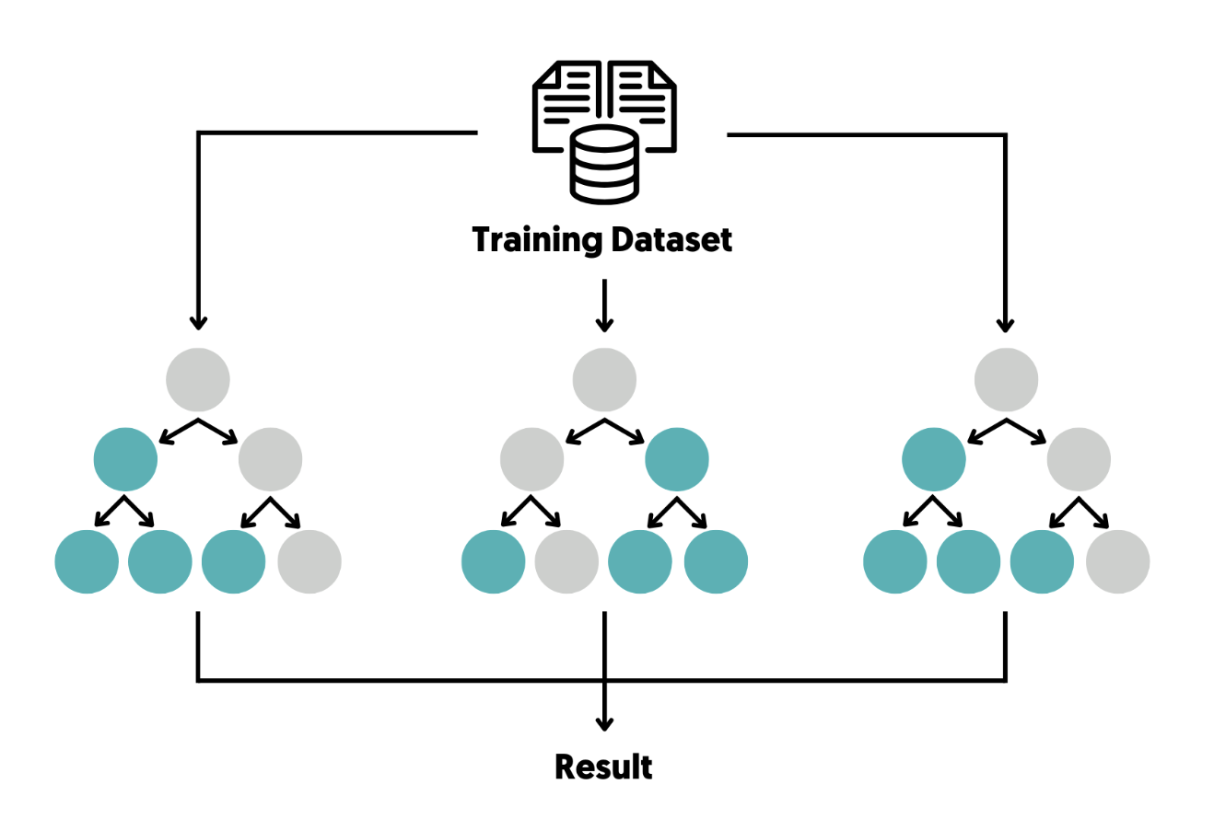
Analysis Method
Random Forest Classification
(Feature Importance)

Slide 5
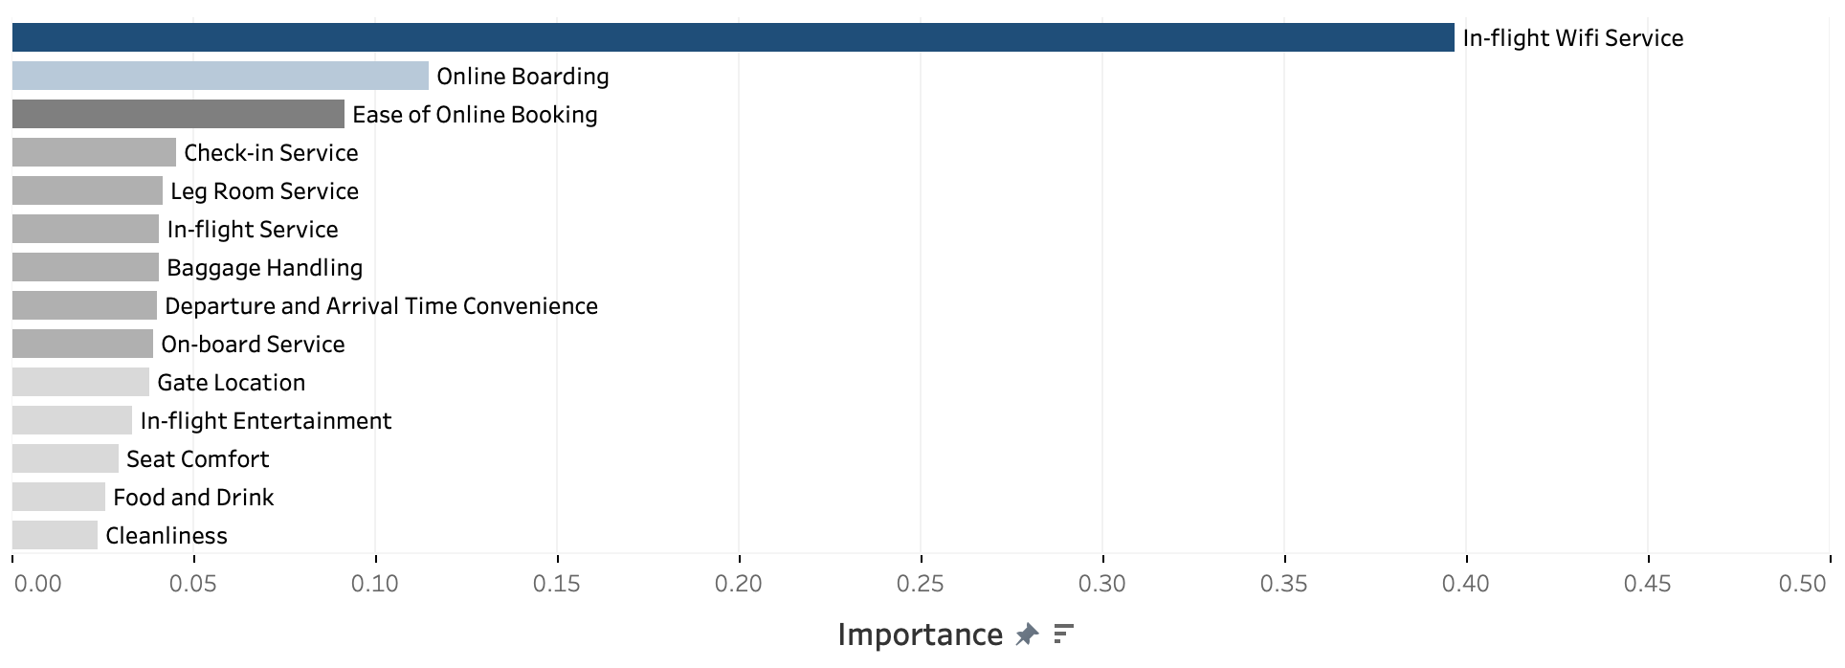
Service Importance for Economy Class | Total Market
By Analysing Passenger Satisfaction Drivers.
245.51%
1
2
3
In-flight Wi-Fi Digital connectivity is the primary factor determining satisfaction for the ECONOMY CABIN, regardless of passenger age.
Online Boarding and Ease of Booking ranked as the second and third most important factors for the ECONOMY CLASS passengers.

Slide 6


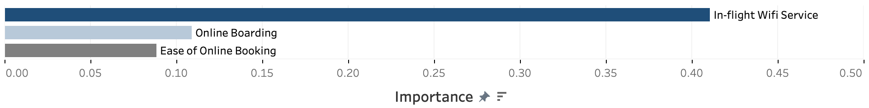
Service Importance for Economy Class | Generations
By Analysing Passenger Satisfaction Drivers.
Gen X
Millennials
Gen Z
The results show that all three generations (Gen X, Millennials, and Gen Z) place a similar level of importance on services in ECONOMY CLASS flights.

Slide 7
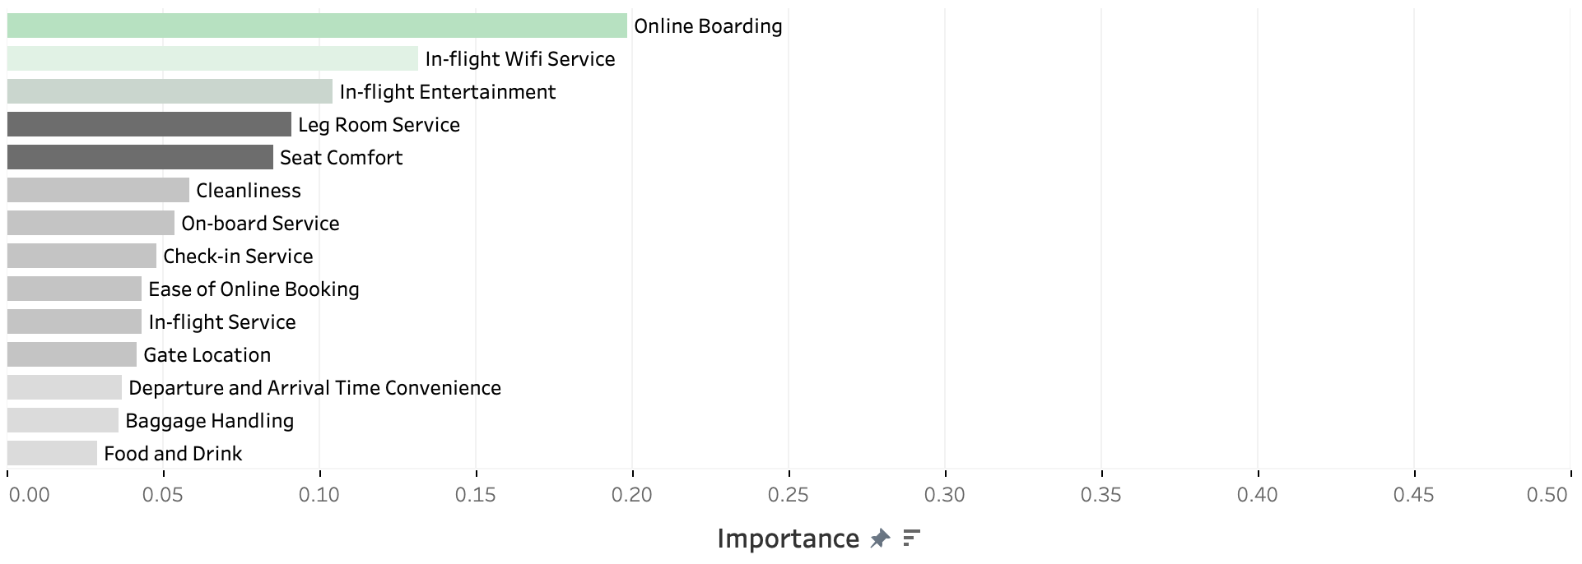
Service Importance for Business Class | Total Market
By Analysing Passenger Satisfaction Drivers.
1
2
3
4
5
Consistent with Economy results, Online Boarding and In-flight Wi-Fi remain the top two drivers for Business Class satisfaction.
In-flight Entertainment completes the top 3, indicating that Business Class passengers place significantly higher value on leisure and connectivity.
Unlike Economy, physical amenities like Leg Room Service and Seat Comfort enter the top 5, showing their critical role in the premium experience.

Slide 8

Service Importance for Business Class | Generations
By Analyzing Passenger Satisfaction Drivers.
Gen X
Millennials
Gen Z
Gen X : Leg Room Service and Seat Comfort are the most important features for Gen X passengers, emphasizing the value they place on the physical comfort and cabin environment.
Millennials : Online Boarding and In-flight Entertainment are the most important features, showing content quality and digital connectivity importance
Gen Z : Online Boarding and In-flight Wi-Fi are the most important features, highlighting their reliance on seamless, high-speed digital interaction.

Slide 9
Results Summary
Total Passengers
Economy Class
Business Class
In-flight Wi-Fi emerges as the most important service in driving passenger satisfaction, outperforming Online Boarding (the second most important factor) and Ease of Online Booking (the third) by a substantial margin of +245.51%.
Online Boarding, In-flight Wi-Fi Service, and In-flight Entertainment rank as the first, second, and third most important features, respectively.
The importance of Leg Room Service and Seat Comfort is considerable, placing them in fourth and fifth positions.

Slide 10
Results Summary
Generational Segmentation
Economy Class
Business Class
All generations show similar service preferences, with In-flight Wi-Fi ranked first by a large margin (over 240% higher than second), followed by Online Boarding and Ease of Online Booking.
Online Boarding is important across all segments; Gen Z and Millennials prioritise connectivity (In-flight Wi-Fi), with Millennials also valuing In-flight Entertainment, while Gen X places greater emphasis on physical comfort, particularly Leg Room Service and Seat comfort.

Slide 11
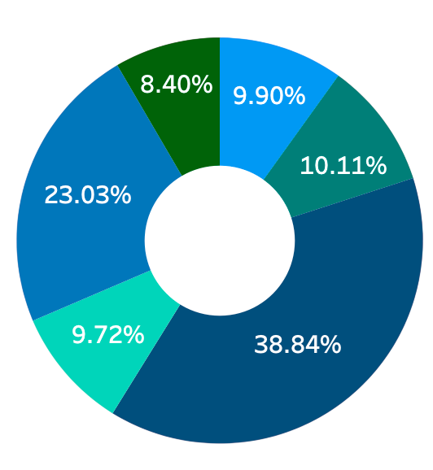
Strategic Investment Recommendations
Seat Comfort
Ease of Online Booking
In-flight Entertainment
Online Boarding
In-flight Wi-Fi Service
Leg Room Service
Recommended budget allocation, based on the aggregated importance of services, is illustrated in the pie chart for the six most important services.

Slide 12
Targeted Marketing Recommendations
Economy Class Passengers: Promote digital connectivity, with a strong emphasis on in-flight Wi-Fi services.
Gen X Business Class Passengers: Highlight physical comfort features, particularly legroom and seat comfort.
Millennials Business Class Passengers: Emphasise in-flight entertainment alongside digital connectivity.
Gen Z Business Class Passengers: Focus on digital connectivity, particularly Wi-Fi quality and speed.

Slide 13
Thank You

