Slide 1
Cyclistic 2024
Presented by: Sahand Piri
Last Updated: February 10th, 2025

Slide 2
Project Objective
To identify how annual members use Cyclistic bicycles differently from casual riders in order to support the marketing team in developing targeted strategies to convert casual riders into annual members.

Slide 3
Analysis Method
Part 1
Part 2
Yearly
Weekday
Seasonal
Timezone
Monthly

Slide 4
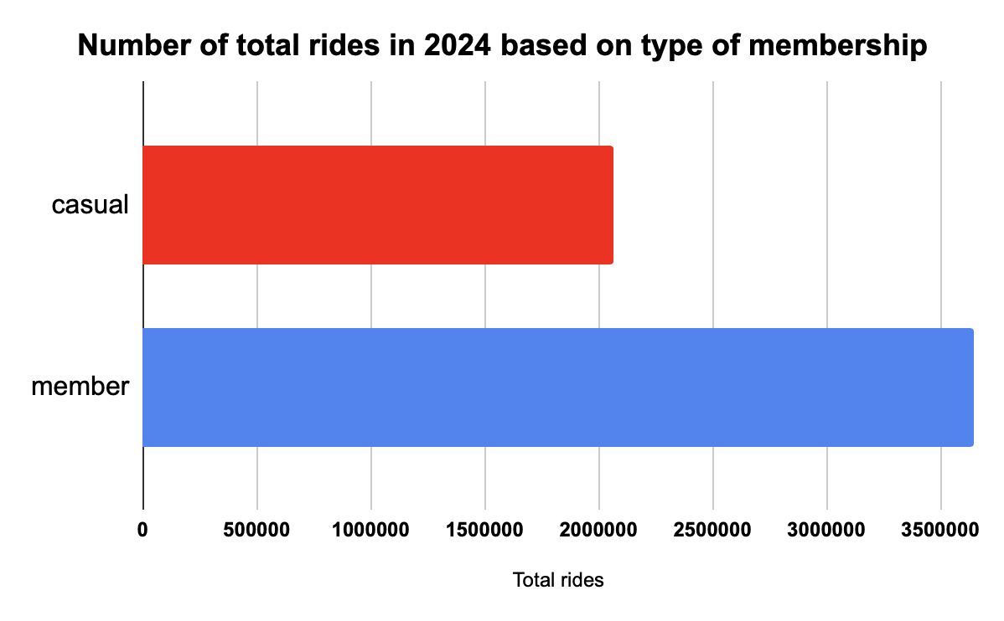
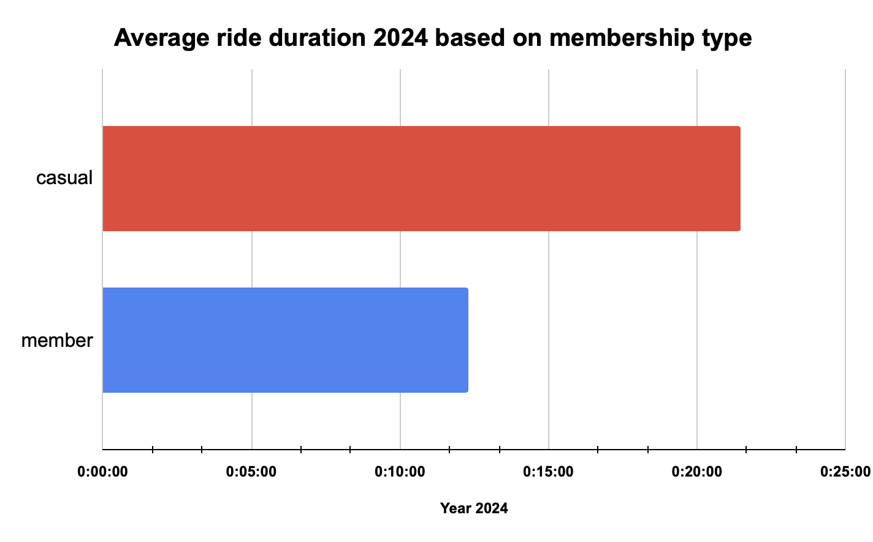
Yearly Analysis
+3.6 Million member rides
+2 Million casual rides
+76% more rides by members
AVG member ride duration: +12 minutes
AVG casual ride duration: +21 minutes
Casual riders ride length is almost +75% more than members

Slide 5
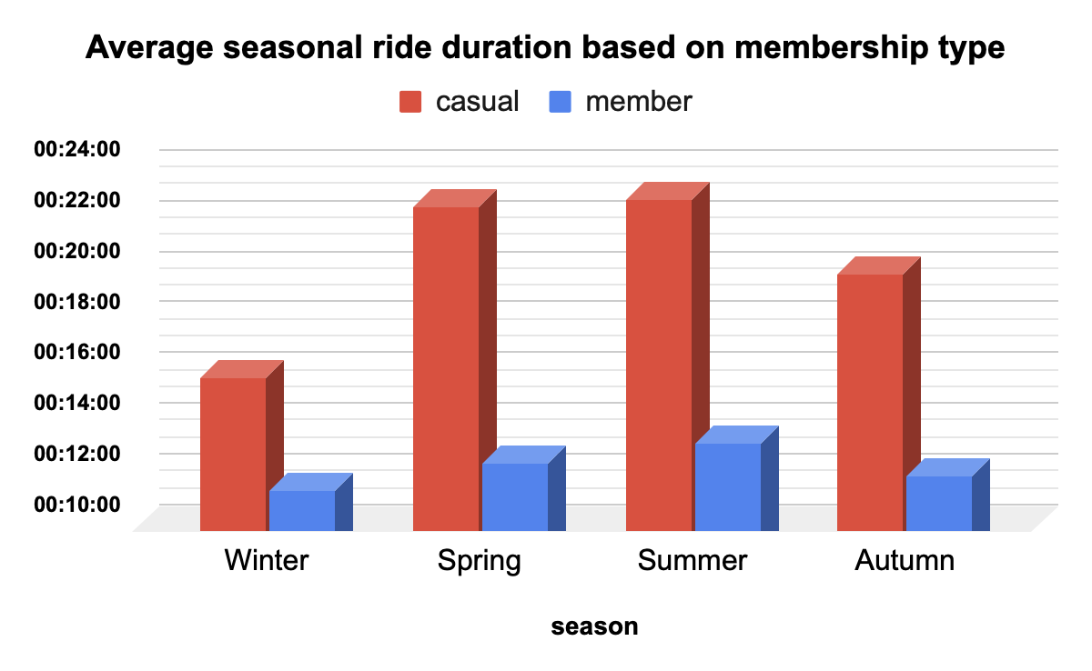
Seasonal Analysis
Ride duration by season
Winter
Spring
Summer
Autumn
Members: ride length in all season are almost same (Between +11 and +13 minutes).
Casual riders: ride length in spring and summer is +22 minutes while in winter +19 and in winter is +19.
Key takeaway: Significant ride length reduction in colder seasons by casual riders.
Member
Casual
+11
+12
+13
+11
+15
+22
+22
+19

Slide 6
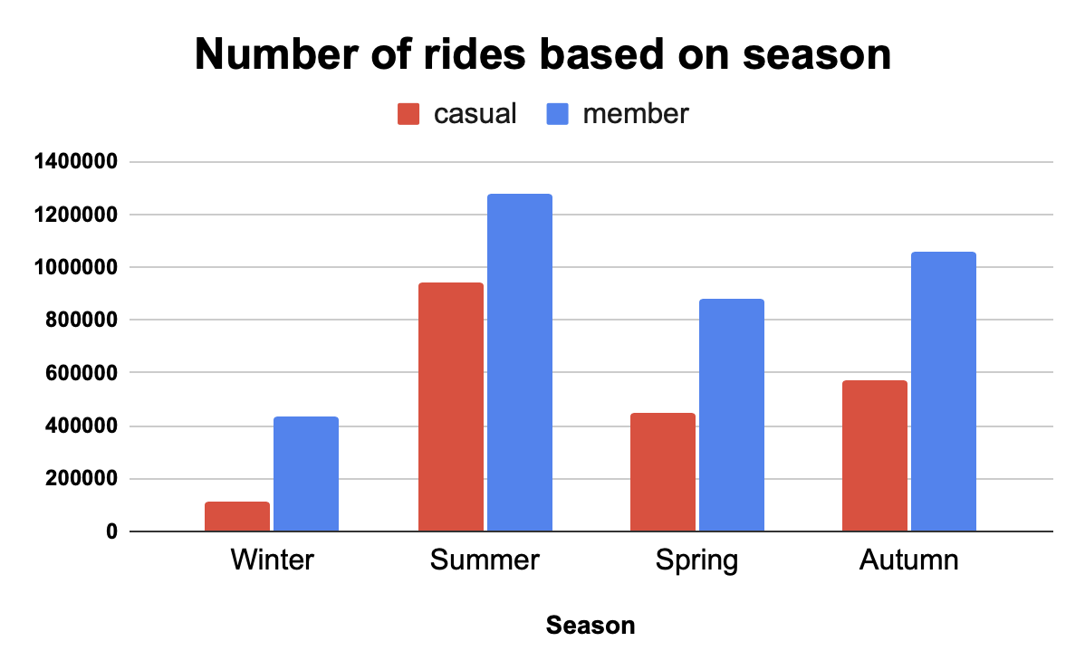
Seasonal Analysis
Ride percentage by season
Winter
Spring
Summer
Autumn
In warmer seasons number of rides based on percentage is higher in both casuals and members.
For both members and casual riders summer is most favorite season.
Key difference: +12% of members from total member rides used bicycles in winter while this amount is +5% for casual riders.
Member
Casual
12.1%
24.4%
35.5%
28%
5.3%
21.5%
45.5%
27.7%

Slide 7
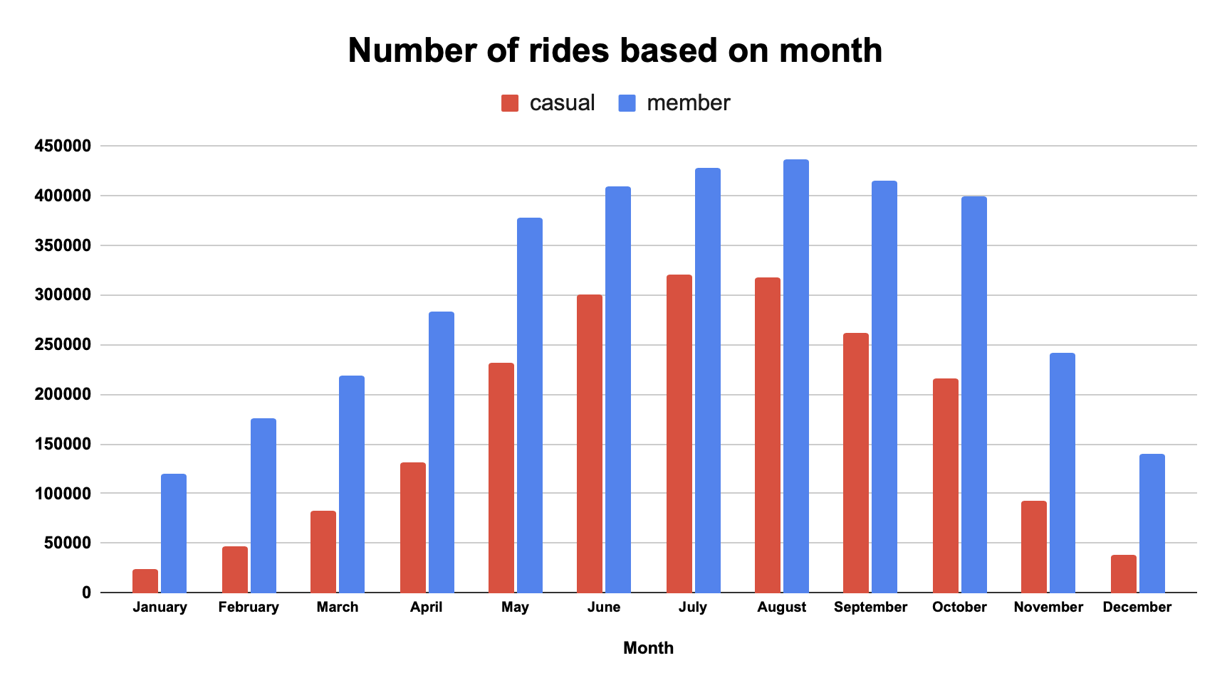
Monthly Analysis
Key difference: The proportion of rides between members and casual riders, which varies significantly based on the total number of rides.
During colder months, member riders ride an impressive +400% more than casual riders
In warmer months, the difference narrows to a maximum of 34.7%.
Member
+37.4% more rides
Member
+400% more rides

Slide 8
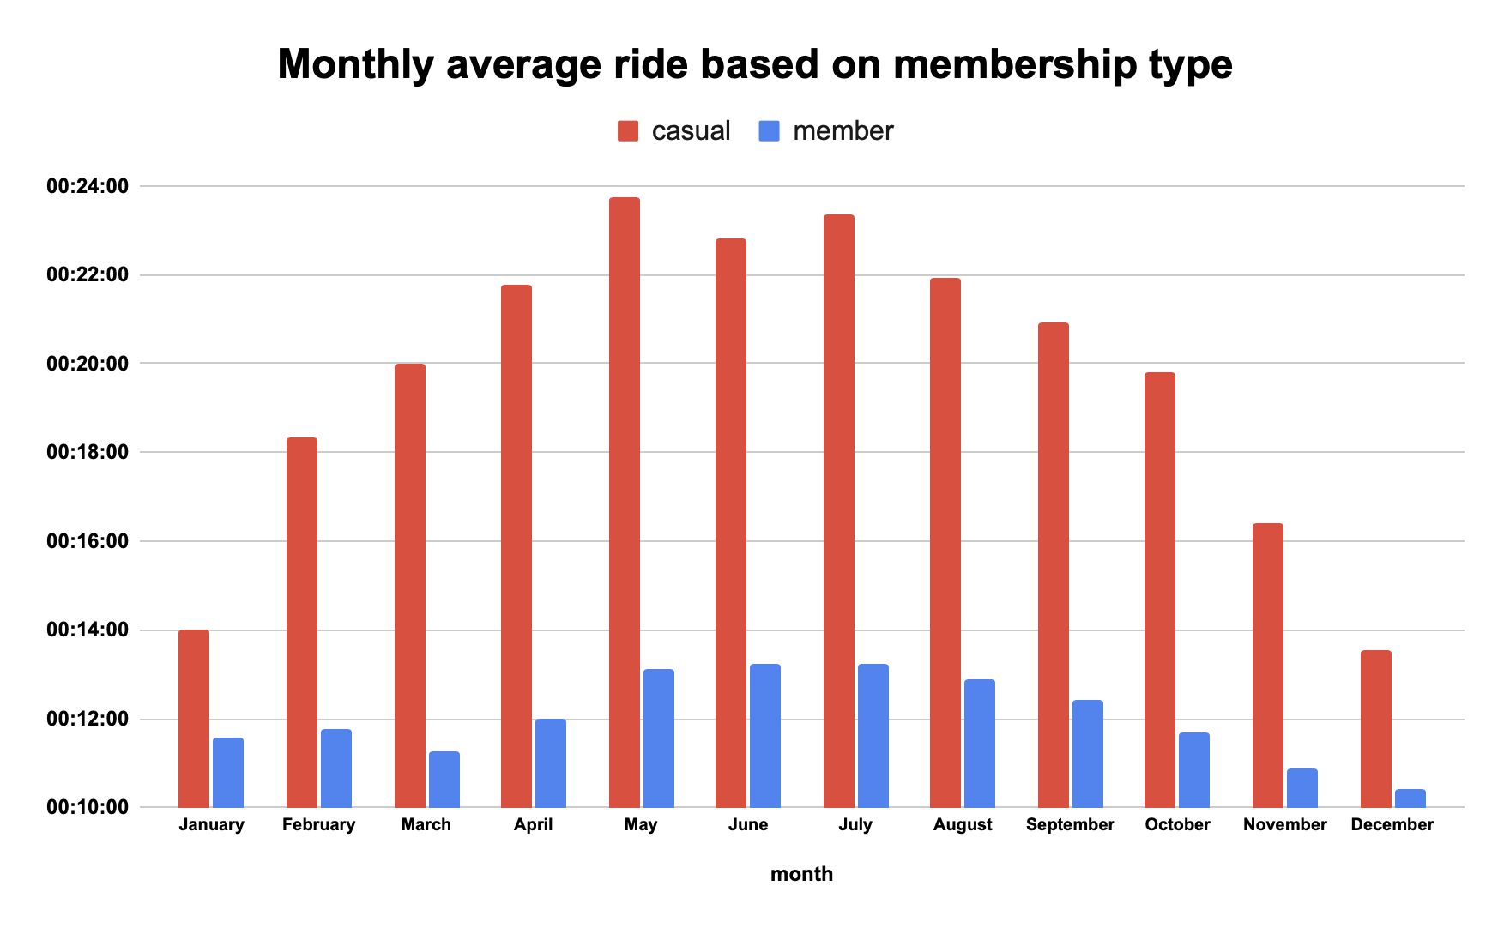
Monthly Analysis
Key difference: The proportion of ride length between members and casual riders is significantly different.
During colder months, casual riders, ride duration is 77% more than members
In warmer months, the difference narrows to a maximum of 18%.
Casual riders
77% more ride length
Casual riders
18% more ride length

Slide 9
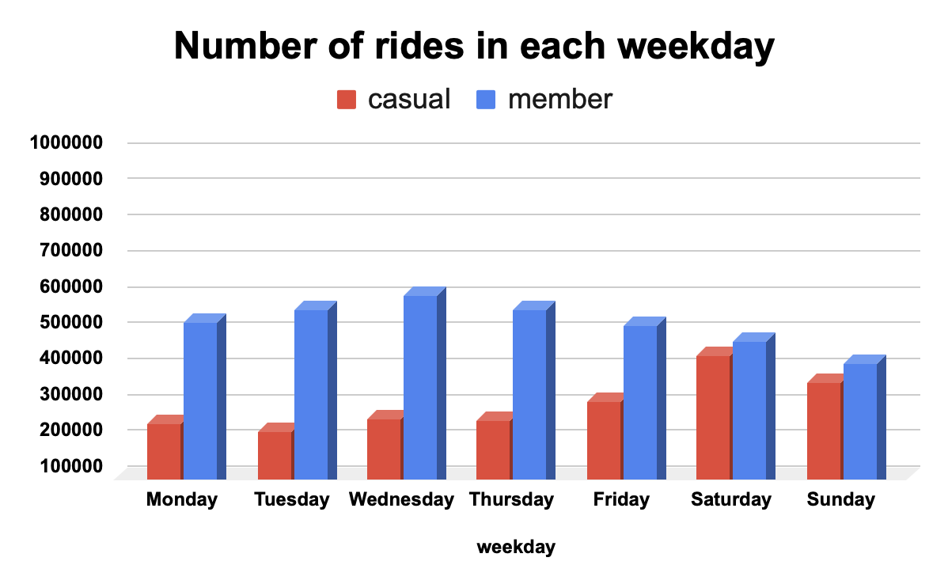
Weekday Analysis
Key difference: in the weekends, number of casual riders significantly increases while number of member riders slightly decreases.
During work days, members ride significantly more than casual riders (133% more in average)
During weekends casual riders number significantly increases and they narrow down differences to on 15%
Members
ride 133% more
Members
ride 15% more

Slide 10
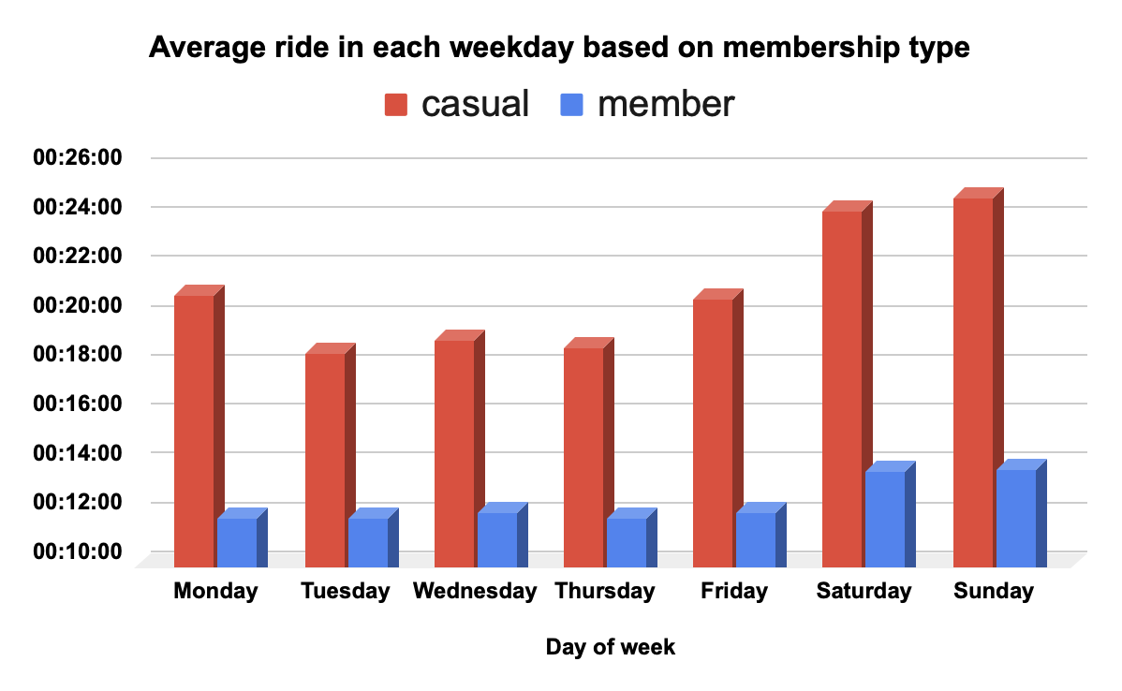
Weekday Analysis
During workdays casual riders average ride length is +18 minutes.
During weekends casual riders average ride length is +24 minutes.
Key difference: casual riders, ride length is around 70% more than members.

Slide 11
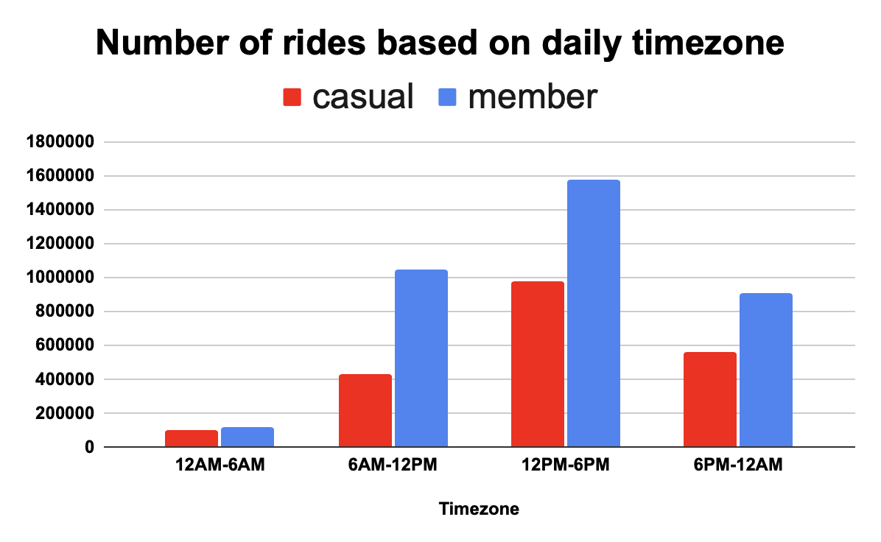
Daily Timezone Analysis
Most preferred time zones for both members and casual riders are 6AM-12PM, 12PM-6PM, and 6PM-12AM.
Key difference: While 6AM-12PM is members second preferred time zone, casual riders second preferred time zone is 6PM-12PM.

Slide 12
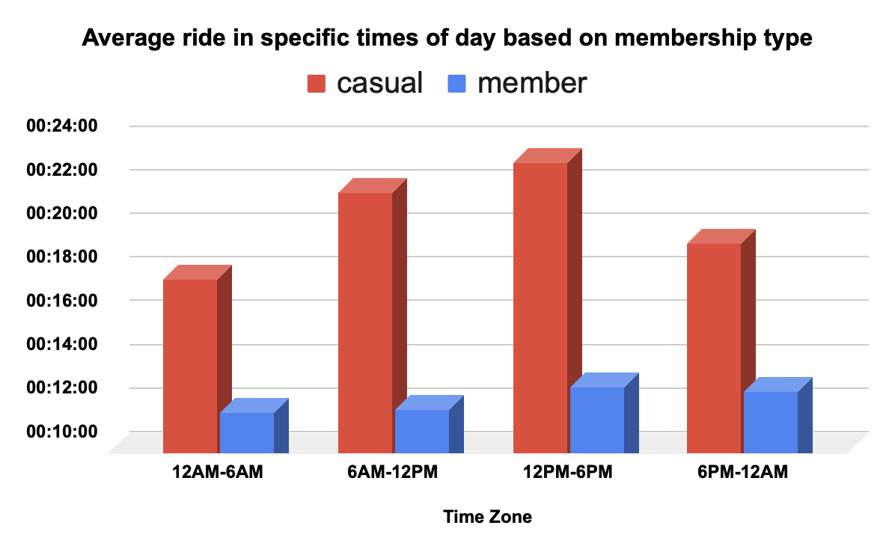
Daily Timezone Analysis
Member average ride length is partially consistent.
Casual riders journeys between 6AM-12PM and 12PM-6PM are the longests (+20 minutes).
Key difference: casual riders, ride length is significantly more than members in daily basis.

Slide 13
Part 1: Key Differences
Members ride 76% more frequently than casual riders.
Casual riders’ average ride length is 75% longer than members.
Both groups show a significant decrease in rides during colder months.
In cold months, members take 400% more rides than casual riders; in warmer months, the gap drops to 37.4%.
Average ride length difference is 18% in January (cold) and rises to 77% in May (warm), with casual riders riding longer.

Slide 14
Part 2: Key Differences
Casual riders’ number of rides is significantly higher on weekends, while members ride significantly more on weekdays.
The ride frequency gap between members and casual riders is 133% on weekdays, but narrows to 15% on weekends.
Casual riders’ average ride length exceeds 24 minutes on weekends, which is 70% longer than members (compared to 50% longer on weekdays).
For both groups, ride frequency peaks between 12 PM – 6 PM. The second-highest period is 6 AM – 12 PM for members and 6 PM – 12 AM for casual riders.
On a daily basis, casual riders consistently have a longer average ride duration than members.

Slide 15
Recommendations
Casual riders demonstrate peak usage during warmer months and weekends, and their average ride length exceeds that of members. This suggests that casual riders are primarily leisure-oriented, whereas members likely use the service for more routine or utilitarian purposes, such as commuting.
Best Months for Campaigns: April, May, June, July, August, and September
Best Days: Friday, Saturday, and Sunday
Best Timeframe: 9:00 AM – 9:00 PM
Primary Target Segment: Leisure-oriented riders

Slide 16
Thank You

